Slide 1
Iterative Development & Unified Process
Informally, a software development process describes an approach to building,deploying, and possibly maintaining software.
The Unified Process (UP) combines commonly accepted best practices, such as an iterative lifecycle and risk-driven development, into a cohesive and well-documented
description.

Slide 2
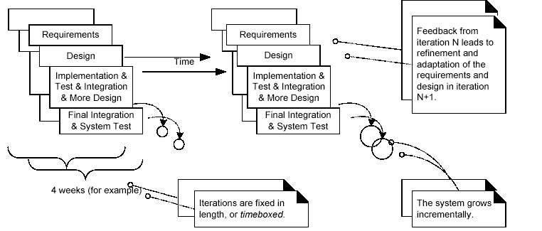
The Most Important UP Idea: Iterative Development

Slide 3
Benefits of Iterative Development
• early rather than late mitigation of high risks (technical, requirements,objectives, usability, and so forth)
• early visible progress
• early feedback, user engagement, and adaptation, leading to a refined system that more closely meets the real needs of the stakeholders
• managed complexity; the team is not overwhelmed by "analysis paralysis" over long and complex steps
• the learning within an iteration can be methodically used to improve thedevelopment process itself, iteration by iteration

Slide 4
Additional UP Best Practices and Concepts
Some additional best practices and key concepts in the UP include:
• tackle high-risk and high-value issues in early iterations
• continuously engage users for evaluation, feedback, and requirements
• build a cohesive, core architecture in early iterations
• continuously verify quality; test early, often, and realistically
• apply use cases
• model software visually (with the UML)
• carefully manage requirements
• practice change request and configuration management

Slide 5
The UP Phases
A UP project organizes the work and iterations across four major phases:
1. Inception— approximate vision, business case, scope, vague estimates.
2. Elaboration—refined vision, iterative implementation of the core architecture, resolution of high risks, identification of most requirements and scope,more realistic estimates.
3. Construction—iterative implementation of the remaining lower risk and easier elements, and preparation for deployment.
4. Transition—beta tests, deployment.

Slide 6
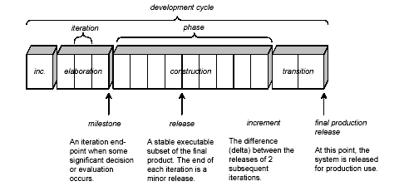
Schedule-Oriented Terms in UP

Slide 7
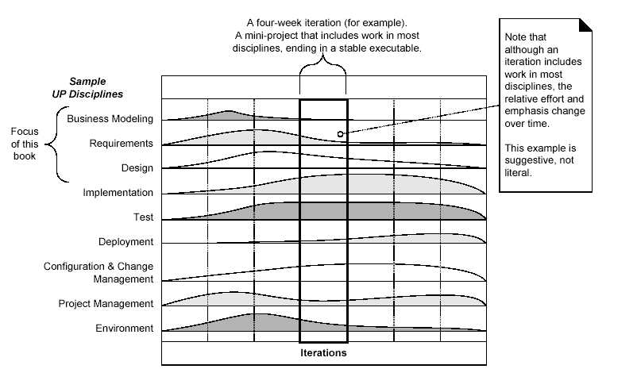
The UP Disciplines

Slide 8
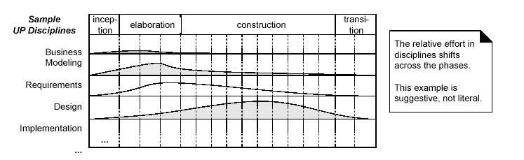
Disciplines and Phases

Slide 9
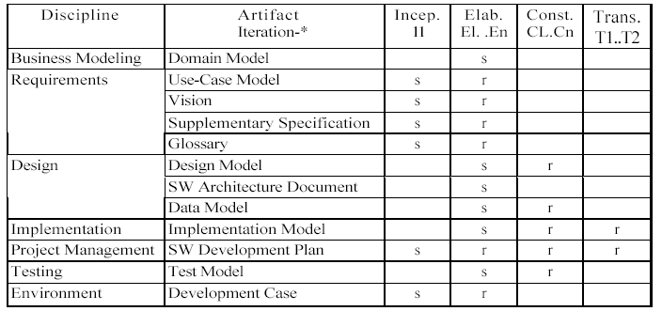
The Sample Development Case of UP Artifacts

Slide 10
Case Study : The NextGen POS System
A POS system is a computerized application used(in part) to record sales and handle payments; it is typically used in a retail store. It includes hardware components such as a computer and bar code scanner,and software to run the system. It interfaces to various service applications, such as a third-party tax calculator and inventory control. These systems must be relatively fault-tolerant; that is, even if remote services are temporarily unavailable (such as the inventory system), they must still be capable of capturing sales and handling at least cash payments (so that the business is not crippled).

Slide 11
Architectural Layers and Case Study Emphasis
A typical object-oriented information system is designed in terms of several architectural layers or subsystems
• User Interface—graphical interface; windows.
• Application Logic and Domain Objects—software objects representing domain concepts (for example, a software class named Sale) that fulfill application requirements.
• Technical Services—general purpose objects and subsystems that provide supporting technical services, such as interfacing with a database or error logging. These services are usually application-independent and reusable across several systems.

Slide 12
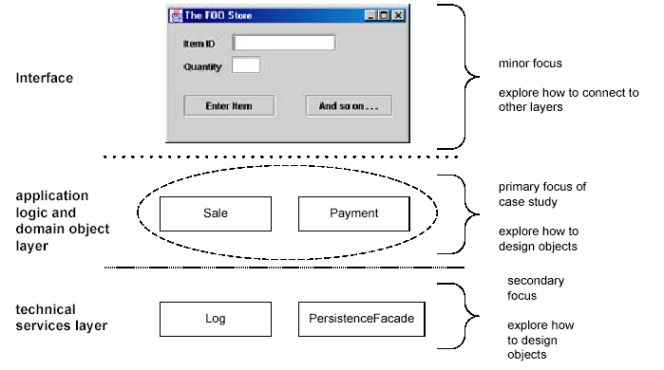
Sample Layers

Slide 13
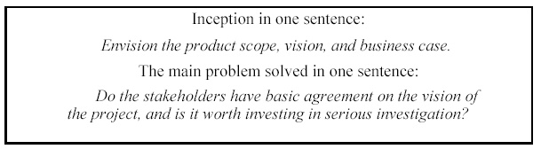
Inception Phase

Slide 14
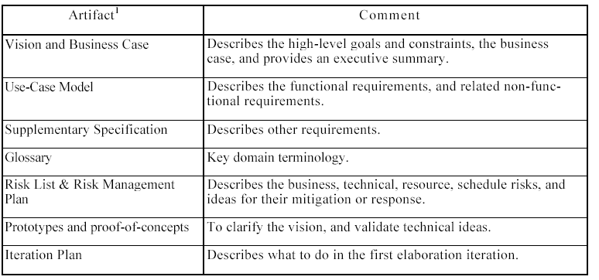
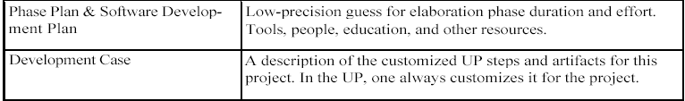
Artifacts That May Starts in Inception

Slide 15
Understanding Requirements
Requirements are capabilities and conditions to which the system—and more broadly, the project—must conform [JBR99].
A prime challenge of requirements work is to find, communicate, and remember (that usually means record) what is really needed, in a form that clearly speaks to the client and development team members.
The UP promotes a set of best practices, one of which is manage requirements: a systematic approach to finding, documenting, organizing, and tracking the changing requirements of a system"

Slide 16
Types of Requirements-FURPS+
• Functional—features, capabilities, security.
• Usability—human factors, help, documentation.
• Reliability—frequency of failure, recoverability, predictability.
• Performance—response times, throughput, accuracy, availability, resource usage.
• Supportability—adaptability, maintainability, internationalization,
configurability.
The "+" in FURPS+ indicates ancillary and sub-factors, such as:
• Implementation—resource limitations, languages and tools, hardware, ...
• Interface—constraints imposed by interfacing with external systems.
• Operations—system management in its operational setting.
• Packaging
• Legal—licensing and so forth.

Slide 17
Use-Case Model : Writing Requirements in Context
Use-Cases are the user centric view of the system functionality
Informally, they are stories of using a system to meet goals. Here
is an example brief format use case:
Process Sale: A customer arrives at a checkout with items to
purchase. The cashier uses the POS system to record each purchased
item. The system presents a running total and line-item
details. The customer enters payment information, which the
system validates and records. The system updates inventory.
The customer receives a receipt from the system and then leaves
with the items.

Slide 18
Terminology
an actor is something with behavior, such as a person (identified by
role), computer system, or organization; for example, a cashier.
A scenario is a specific sequence of actions and interactions between actors and the system under discussion; it is also called a use case instance. It is one particular story of using a system, or one path through the use case; for example, the scenario of successfully purchasing items with cash, or the scenario of failing to purchase items because of a credit card transaction denial.
Informally then, a use case is a collection of related success and failure scenarios that describe actors using a system to support a goal.

Slide 19
An Example
Handle Returns
Main Success Scenario: A customer arrives at a checkout with
items to return. The cashier uses the POS system to record each
returned item ...
Alternate Scenarios:
If the credit authorization is reject, inform the customer and ask
for an alternate payment method.
If the item identifier is not found in the system, notify the Cashier
and suggest manual entry of the identifier code (perhaps it is
corrupted).
If the system detects failure to communicate with the external
tax calculator system, ...

Slide 20
Uses Cases and Adding Value
A key attitude in use case work is to focus on the question "How can using the system provide observable value to the user, or fulfill their goals?", rather than merely thinking of system requirements in terms of a "laundry list" of features or functions.
This is a key idea that Jacobson was trying to convey in the use case concept: Do requirements work with a focus on how a system can add value and fulfill goals.

Slide 21
Use Case Types
Use cases are written in different formats, depending on need. In addition to the black-box versus white-box visibility type, use cases are written in varying degrees of formality:
• brief—terse one-paragraph summary, usually of the main success scenario.
• casual—informal paragraph format. Multiple paragraphs that cover various scenarios. The prior Handle Returns example was casual.
• fully dressed—the most elaborate. All steps and variations are written in detail, and there are supporting sections, such as preconditions and success guarantees.

Slide 22
Fully Dressed Example: Process Sale
Use Case UC1: Process Sale
Primary Actor: Cashier
Stakeholders and Interests:
Cashier: Wants accurate, fast entry, and no payment errors, as cash drawer shortages are deducted from his/her salary.
- Salesperson: Wants sales commissions updated.
- Customer: Wants purchase and fast service with minimal effort. Wants proof of purchase to support returns.
- Company: Wants to accurately record transactions and satisfy customer interests. Wants to ensure that Payment Authorization Service payment receivables are recorded. Wants some fault tolerance to allow sales capture even if server components (e.g., remote credit validation) are unavailable. Wants automatic and fast update of accounting and inventory.
- Government Tax Agencies: Want to collect tax from every sale. May be multiple agencies, such as national, state, and county.
- Payment Authorization Service: Wants to receive digital authorization requests in the correct format and protocol. Wants to accurately account for their payables to the store.

Slide 23
Preconditions: Cashier is identified and authenticated.
Success Guarantee (Postconditions): Sale is saved. Tax is correctly calculated.
Accounting and Inventory are updated. Commissions recorded. Receipt is generated.
Payment authorization approvals are recorded.
Main Success Scenario (or Basic Flow):
1. Customer arrives at POS checkout with goods and/or services to purchase.
2. Cashier starts a new sale.
3. Cashier enters item identifier.
4. System records sale line item and presents item description, price, and running total.
Price calculated from a set of price rules.
Cashier repeats steps 3-4 until indicates done.
5. System presents total with taxes calculated.
6. Cashier tells Customer the total, and asks for payment.
7. Customer pays and System handles payment.
8. System logs completed sale and sends sale and payment information to the external
Accounting system (for accounting and commissions) and Inventory system (to
update inventory).
9. System presents receipt.
10.Customer leaves with receipt and goods (if any).

Slide 24
Extensions (or Alternative Flows):
*a. At any time, System fails:
To support recovery and correct accounting, ensure all transaction sensitive state
and events can be recovered from any step of the scenario.
1. Cashier restarts System, logs in, and requests recovery of prior state.
2. System reconstructs prior state.
2a. System detects anomalies preventing recovery:
1. System signals error to the Cashier, records the error, and enters a clean
state.
2. Cashier starts a new sale.
3a. Invalid identifier:
1. System signals error and rejects entry.
3b. There are multiple of same item category and tracking unique item identity not
important (e.g., 5 packages of veggie-burgers):
1. Cashier can enter item category identifier and the quantity.
3-6a: Customer asks Cashier to remove an item from the purchase:
1. Cashier enters item identifier for removal from sale.
2. System displays updated running total.
3-6b. Customer tells Cashier to cancel sale:
1. Cashier cancels sale on System.

Slide 25
3-6c. Cashier suspends the sale:
1. System records sale so that it is available for retrieval on any POS terminal.
4a. The system generated item price is not wanted (e.g., Customer complained about
something and is offered a lower price):
1. Cashier enters override price.
2. System presents new price.
5a. System detects failure to communicate with external tax calculation system service:
1. System restarts the service on the POS node, and continues.
1a. System detects that the service does not restart.
1. System signals error.
2. Cashier may manually calculate and enter the tax, or cancel the sale.
5b. Customer says they are eligible for a discount (e.g., employee, preferred customer):
1. Cashier signals discount request.
2. Cashier enters Customer identification.
3. System presents discount total, based on discount rules.
5c. Customer says they have credit in their account, to apply to the sale:
1. Cashier signals credit request.
2. Cashier enters Customer identification.
3. Systems applies credit up to price=0, and reduces remaining credit.
6a. Customer says they intended to pay by cash but don't have enough cash:
1a. Customer uses an alternate payment method.
1b. Customer tells Cashier to cancel sale. Cashier cancels sale on System.

Slide 26
7a. Paying by cash:
1. Cashier enters the cash amount tendered.
2. System presents the balance due, and releases the cash drawer.
3. Cashier deposits cash tendered and returns balance in cash to Customer.
4. System records the cash payment.
7b. Paying by credit:
1. Customer enters their credit account information.
2. System sends payment authorization request to an external Payment Authoriza
tion Service System, and requests payment approval.
2a. System detects failure to collaborate with external system:
1. System signals error to Cashier.
2. Cashier asks Customer for alternate payment.
3. System receives payment approval and signals approval to Cashier.
3a. System receives payment denial:
1. System signals denial to Cashier.
2. Cashier asks Customer for alternate payment.
4. System records the credit payment, which includes the payment approval.
5. System presents credit payment signature input mechanism.
6. Cashier asks Customer for a credit payment signature. Customer enters signa
ture.
7c. Paying by check...
7d. Paying by debit...

Slide 27
7e. Customer presents coupons:
1. Before handling payment, Cashier records each coupon and System reduces
price as appropriate. System records the used coupons for accounting reasons.
1a. Coupon entered is not for any purchased item:
1. System signals error to Cashier. 9a.
9a. There are product rebates:
1. System presents the rebate forms and rebate receipts for each item with a
rebate.
9b. Customer requests gift receipt (no prices visible): 1.
Cashier requests gift receipt and System presents it.
Special Requirements:
- Touch screen Ul on a large flat panel monitor. Text must be visible from 1 meter.
- Credit authorization response within 30 seconds 90% of the time.
- Somehow, we want robust recovery when access to remote services such the inven
tory system is failing.
- Language internationalization on the text displayed.
- Pluggable business rules to be insertable at steps 3 and 7.
Technology and Data Variations List:
3a. Item identifier entered by bar code laser scanner (if bar code is present) or key-
board.
3b. Item identifier may be any UPC, EAN, JAN, or SKU coding scheme.
7a. Credit account information entered by card reader or keyboard.
7b. Credit payment signature captured on paper receipt. But within two years, we pre-
dict many customers will want digital signature capture.

Slide 28
Goals and Scope of a Use Case
Guideline: The EBP Use Case
For requirements analysis for a computer application, focus on use cases at the level of elementary business processes (EBPs).
EBP is a term from the business process engineering field,4 defined as: A task performed by one person in one place at one time, in response to a business event, which adds measurable business value and leaves the data in a consistent state. e.g., Approve Credit or Price Order [original source lost].

Slide 29
Actors have goals (or needs) and use applications to help satisfy them. Consequently, an EBP-level use case is called a user goal-level user case, to emphasize that it serves (or should serve) to fulfill a goal of a user of the system, or the primary actor.
And it leads to a recommended procedure:
1. Find the user goals.
2. Define a use case for each.

Slide 30
Finding Primary Actors, Goals, and Use Cases
Use cases are defined to satisfy the user goals of the primary actors. Hence, the basic procedure is:
1. Choose the system boundary. Is it just a software application, the hardware and application as a unit, that plus a person using it, or an entire organization?
2. Identify the primary actors.those that have user goals fulfilled through using services of the system.
3. For each, identify their user goals. Raise them to the highest user goal level that satisfies the EBP guideline.
4. Define use cases that satisfy user goals; name them according to their goal.

Slide 31
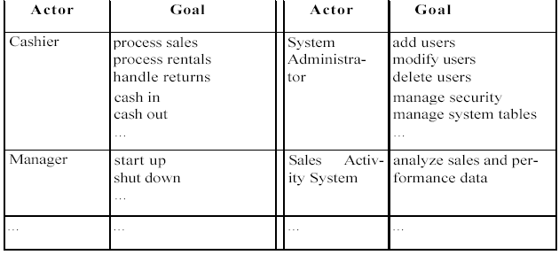
The Actor-Goal List

Slide 32
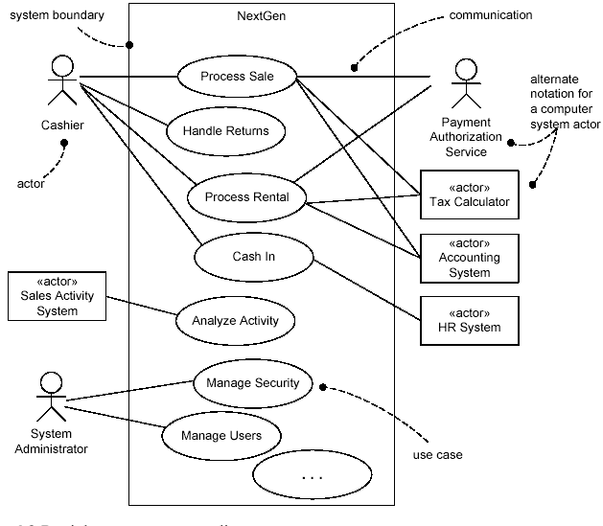
Use Case Diagrams

Slide 33
